Slide 1

Stance Detection System: AI-Powered Stance Detection for Combating Fake News
Group 24
Group Member: Lu Mingrui
Student ID: A0307208L

Slide 2

System Architecture Overview
Input: News headlines and body text.
Preprocessing: Tokenization, normalization, and stopword removal.
Feature Extraction: TF-IDF, Word2Vec, Sentiment Analysis.
Model: SVM, XGBoost, BERT for stance classification.
Evaluation: Model performance assessment using accuracy and F1-score.
Output: Stance classification (agree, disagree, discuss, unrelated) with confidence score.

Slide 3
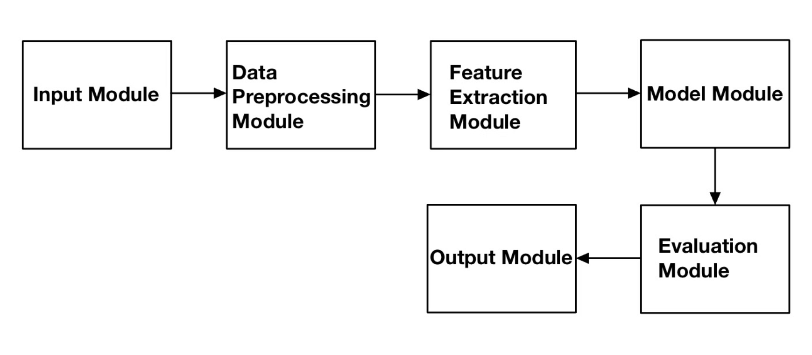
System Architecture Diagram

Slide 4

Input and Preprocessing
Input: Headline and body text.
Preprocessing: Cleaning, tokenization, normalization.
Stopword removal: Removes unnecessary words (e.g., "the", "is").
Lemmatization: Reduces words to their base form (e.g., "running" → "run").

Slide 5
Feature Extraction
TF-IDF
Word2Vec Features
Sentiment Analysis Features
TF-IDF quantifies word significance in documents.
Word2Vec creates dense vectors for words based on context.
Uses Sentiment Intensity Analyzer to score headlines and bodies.
Cosine similarity calculates textual similarity between article parts.
Averages vectors for document-level representation.
Scores indicate emotional tone from positive to negative.
Computes cosine similarity between headlines and bodies.

Slide 6

Core Models
1
Machine Learning Models: SVM, Gradient Boost and Advanced boosting models(XGBoost, CatBoost, LightGBM).
2
Classification Categories: Agrees, Disagrees, Discusses, Unrelated.
3
BERT: Pre-trained transformer model for context-based understanding.

Slide 7
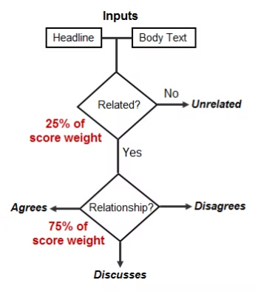
Evaluation Module
Two-Level Scoring System: Reflects the complexity of fake news detection.
Metrics: Accuracy, Precision, Recall, F1-score, confusion matrix.
Cross-validation: Ensures robust model performance.
Best Model Selection: Based on highest score from stance detection and related/unrelated classification.

Slide 8
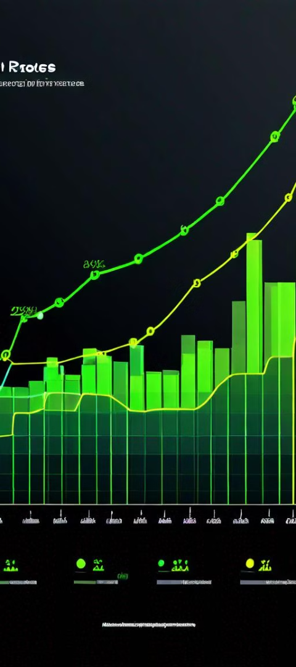
Use Cases:
Use Case1: Media Platform Integration
Use Case2: Fact-Checking Agencies
Automated stance detection for news articles.
Automated assistance for fact-checkers.
Real-time classification of large volumes of content.
Faster and more accurate identification of misinformation.
Scalable to handle millions of articles per day.
Reduces manual workload.

Slide 9
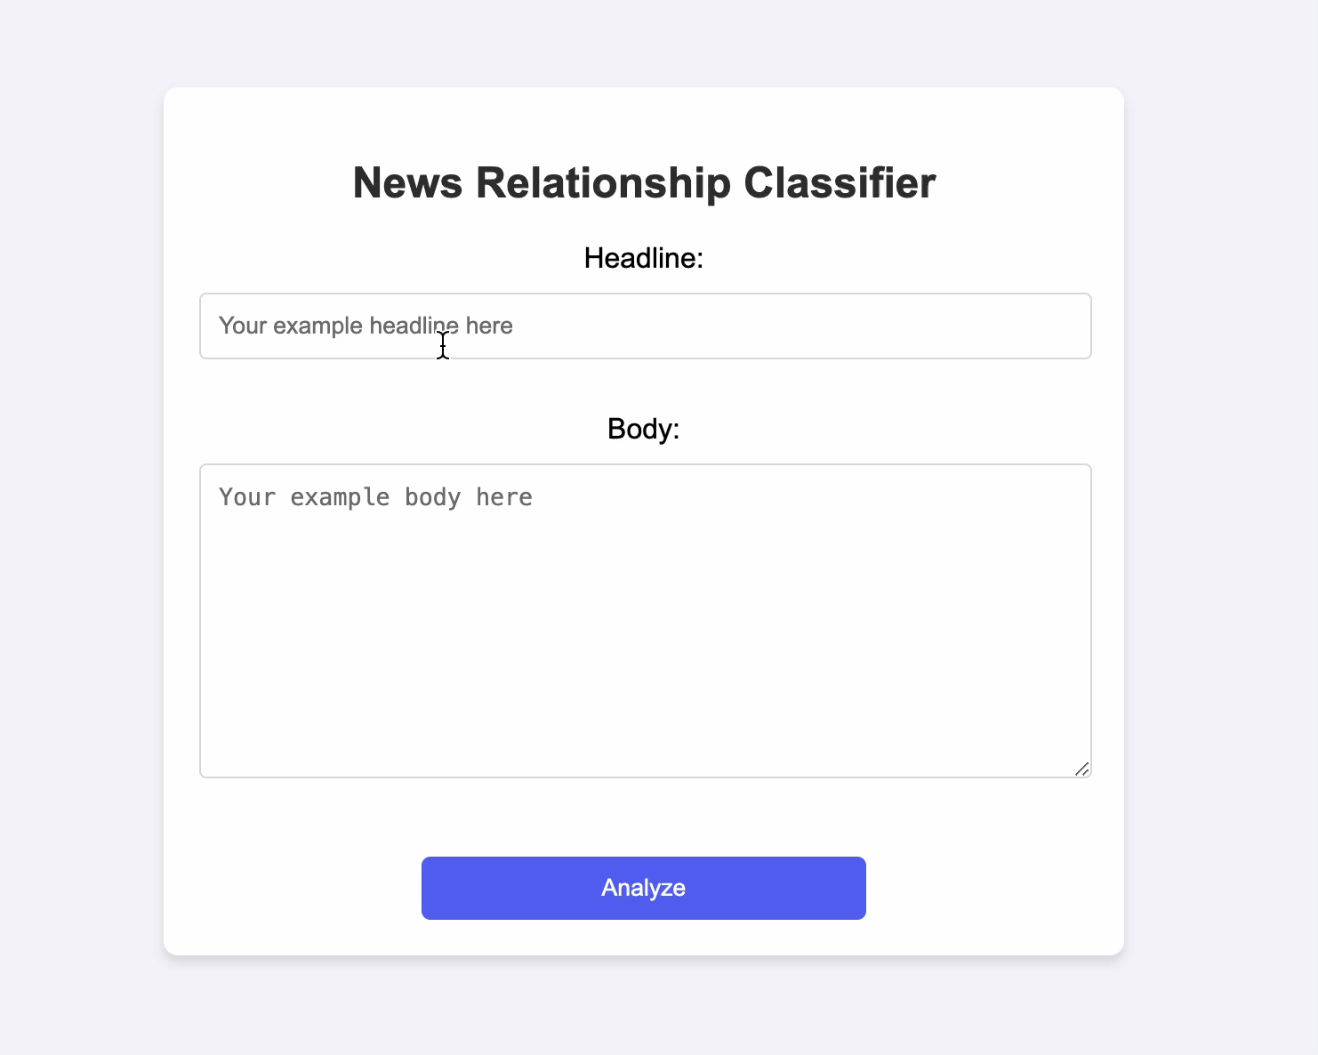
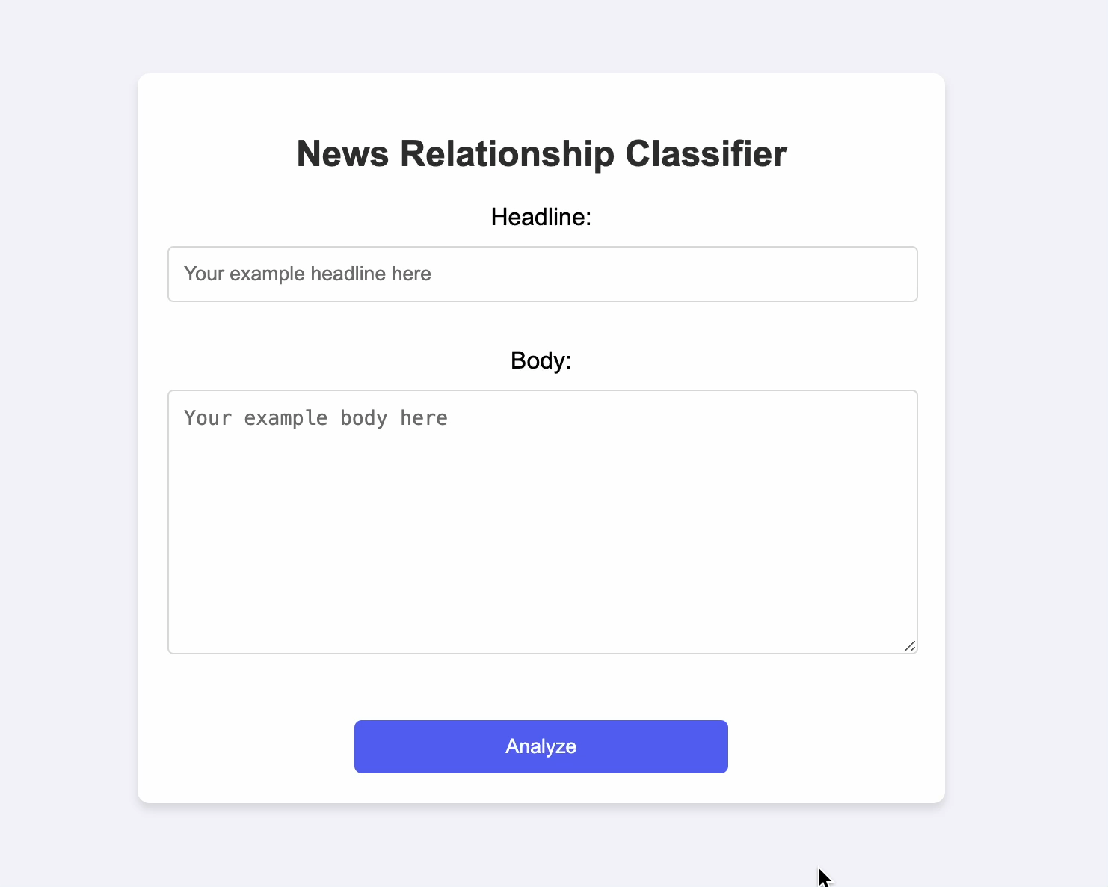
User Interface Demonstration
Unrelated case
Disagree case

Slide 10
Conclusion
Reliable, accurate stance detection system.
Easily integrates into media platforms and fact-checking workflows.
Ready for real-world deployment.

Slide 11
Thank You!

